Slide 1

Partitioning for Beginners
with Microsoft SQL Server

Slide 2
Links for this Session/Workshop
Scripts and Slide Decks https://github.com/db-berater/partitioning-for-beginners
ERP Demo Database (17.00 GB) https://db-berater.de/downloads/ERP_Demo_2012.bak
SQLQueryStress https://github.com/ErikEJ/SqlQueryStress
Windows Admin Center https://go.microsoft.com/fwlink/?linkid=2220149

Slide 3

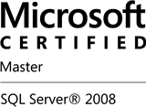


Uwe Ricken db Berater GmbH
I am working with IT-systems since early 1990's and with the main focus on Microsoft SQL Server since version 6.0. I started with development of database applications in 1998 with a professional CRM-System based on Microsoft products (Microsoft Office and Microsoft SQL Server).
Since 2008 I'm focused exclusively on Microsoft SQL Server and working in 3rd level support teams for banks, insurances and global industries.
Since May 2013 I am a Microsoft Certified Master: SQL Server 2008 which was an amazing way into the depth of Microsoft SQL Server.
In July 2013 I have been awarded with the MVP Award for Microsoft SQL Server.
www: http://www.db-berater.de
email: uwe.ricken@db-berater.de
blog: http://www.sqlmaster.de
BlueSky: @sqlbambi

Slide 4
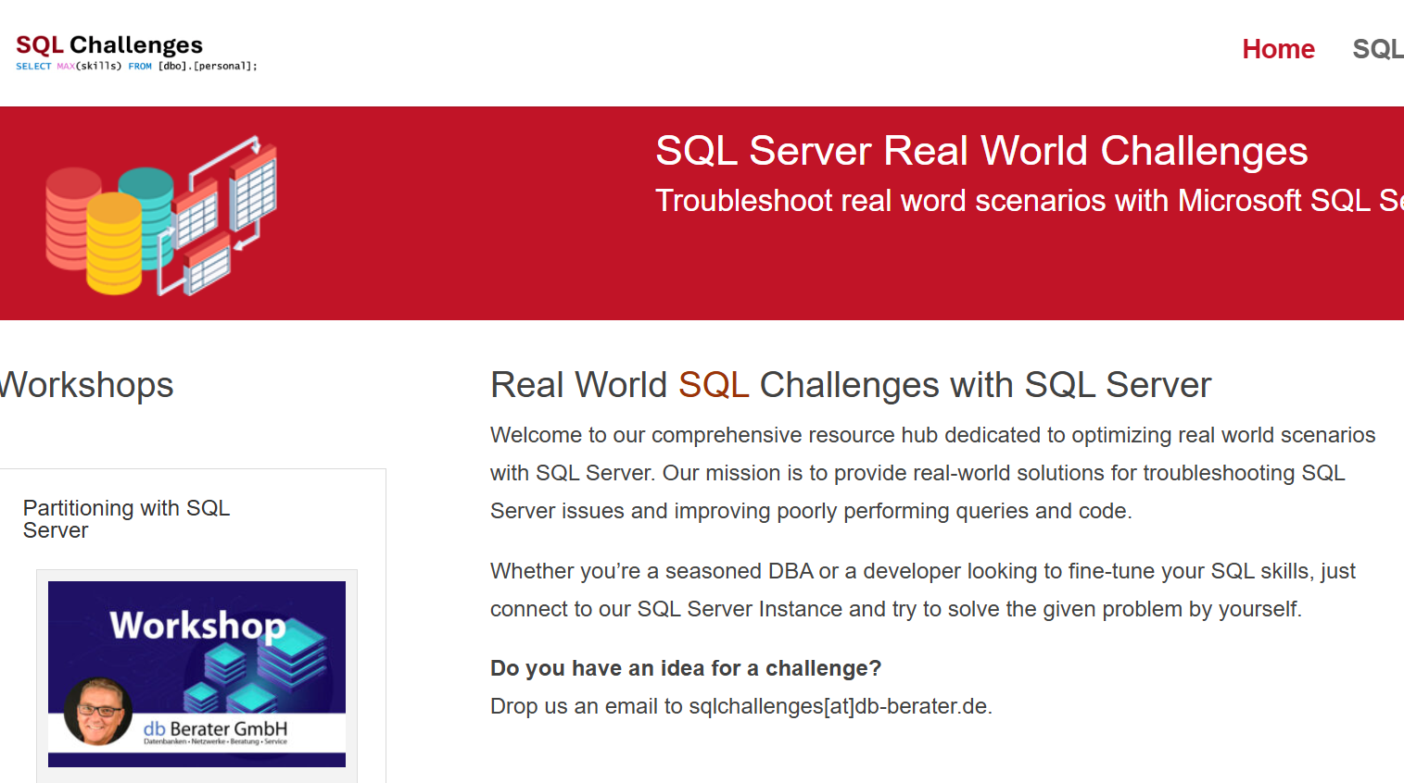
Challenge SQL Server real world scenarios
Get a challenge at least once a month
Connect to a provided SQL Server Instance
Load the challenge scenario
Try to solve it
Blog about your solution
Leave a link in the comments of the challenge to your blog post.
https://sqlchallenges.de

Slide 5
Agenda
What is Partitioning
Data Storage Internals
Partitioning under the Hood
Benefits of Partitioning
Working with Partitioning
[Partitioning – how it begun]
Components of Partitioning
Implementation of Partitioning
How to use
Maintenance

Slide 6
Data Storage Internals
Every Heap / Clustered Index / Nonclustered Index is a separate storage object.
All have the same internal structure!
HEAP / (non)clustered Index
Partition 1
Partition 2
Partition 3
Partition n
In Row Data
data stored directly within a table's data row (max: 8,060 Bytes)
Out Of Row Data
data stored partially outside of the data row if the row size exceeds
LOB Data
Large text elements / documents / pictures / …
Notes:
000 - Basics about relations indexes partitions allocation units pages etc.sql

Slide 7

What is Partitioning?
The data of partitioned tables and indexes are divided into units.
Units can be spread across more than one filegroup in a database.
The data is partitioned horizontally, so that groups of rows are mapped into individual partitions.
All partitions of a single index or table must reside in the same database.
The table or index is treated as a single logical entity when queries or updates are performed on the data.
Prior to SQL Server 2016 (13.x) SP1, partitioned tables and indexes were available only in SQL Server Enterprise Edition.

Slide 8
Partitioning under the hood
dbo.orders
o_orderkey | o_orderdate | o_custkey | …
partition 1
o_orderkey | o_orderdate | o_custkey | …
FILEGROUP
FG 01
Database
File
11249996 2010-10-21 1210007
…
11249984 2011-04-01 949498
…
11250012 2012-07-03 1249211
…
22499979 2013-10-09 1020925
…
22499965 2014-11-12 110962
…
22500004 2015-11-13 393803
…
22499989 2016-10-21 192829
…
11249996 2010-10-21 1210007
…
partition 2
o_orderkey | o_orderdate | o_custkey | …
Database
File
FG 02
11249984 2011-04-01 949498
…
Database
File
partition 3
o_orderkey | o_orderdate | o_custkey | …
FG 03
11250012 2012-07-03 1249211
…
Database
File
partition n
o_orderkey | o_orderdate | o_custkey | …
FG 04
22499989 2016-10-21 192829
…

Slide 9
Benefits / Drawback
Not everything is shiny with Partitioning

Slide 10
Benefits of Partitioning
subsets of data can be transferred or access quickly and efficiently, while maintaining the integrity of a data collection. (e.g. loading data from an OLTP to an OLAP system)
Maintenance operations can be performed on one or more partitions quickly. The operations are more efficient because they target only these data subsets, instead of the whole table.
Query performance may be improved. Do not trust people saying that partitioning has boosted their system!
dbo.orders
o_orderkey | o_orderdate | o_custkey | …
11249996 2010-10-21 1210007
…
11249984 2011-04-01 949498
…
11250012 2012-07-03 1249211
…
22499979 2013-10-09 1020925
…
22499965 2014-11-12 110962
…
22500004 2015-11-13 393803
…
22499989 2016-10-21 192829
…

Slide 11
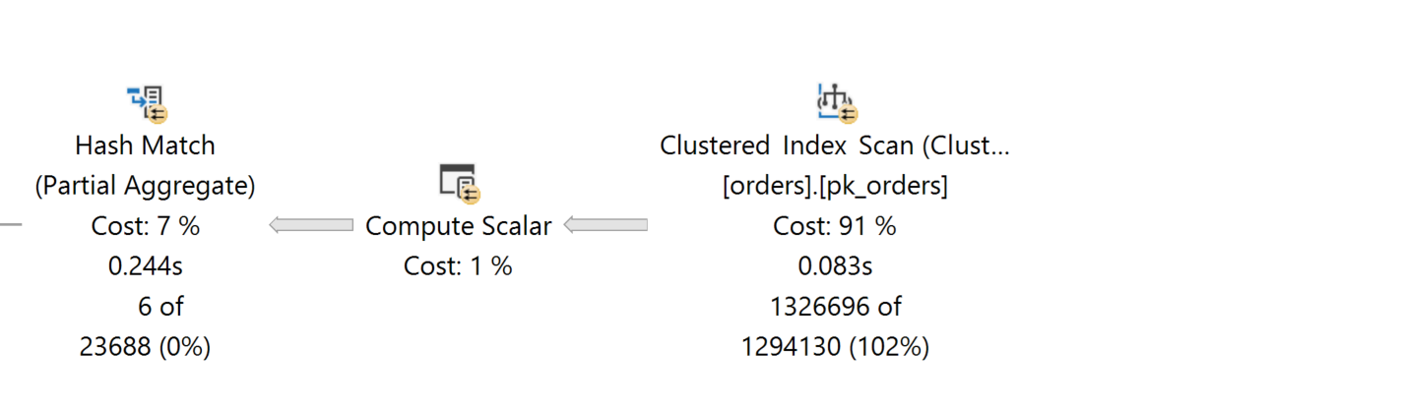
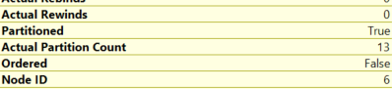
Benefits / drawbacks of partitioned tables!
Benefits
Partition Elimination requires always the partition key as a predicate in your query
Drawbacks
Queries against partitioned tables will run slowly when it comes to aggregations If the partition key is not a predicate for your Nonaligned you will always suffer from FULL SCAN operations.
Indexes will be created as aligned indexes as default. This can cause problem when you run queries against it without knowing this!
Nonaligned indexes avoid optimized handling of data management!
LOCK ESCALATION
Partition Switch IN/OUT
Partition MERGE
SELECT DATE_BUCKET(YEAR, 1, o_orderdate) AS order_year, COUNT_BIG (*) AS order_records FROM dbo.orders GROUP BY DATE_BUCKET(YEAR, 1, o_orderdate) ORDER BY DATE_BUCKET(YEAR, 1, o_orderdate) OPTION(MAXDOP 4);

Slide 12
Working with Partitioning
Components of Partitioning

Slide 13
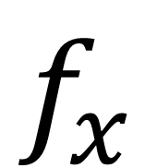
Components of Partitioning
$$f_{x}$$
Partition Function
A partition function is a function that maps the rows of a partitioned table into partitions based on the values of a partitioning column.
partition_id | min value | max value
1 | - ∞ | 0
2 | 1 | 9
3 | 10 | 99
4 | 100 | ∞
CREATE PARTITION FUNCTION pf_demo(INT)
AS RANGE RIGHT FOR VALUES
(1, 10, 100);
GO
partition_id | min value | max value
1 | - ∞ | 1
2 | 2 | 10
3 | 11 | 100
4 | 101 | ∞
CREATE PARTITION FUNCTION pf_demo(INT)
AS RANGE LEFT FOR VALUES
(1, 10, 100);
GO
03 - components of partitioning/01 - partition function.sql

Slide 14

Partition Ranges Partition Function
Partition functions are created as either range left or range right to specify whether the boundary values belong to their left or right partitions:
Range left means that the actual boundary value belongs to its left partition.
It is the last value in the left partition.
Range right means that the actual boundary value belongs to its right partition
It is the first value in the right partition.

Slide 15

Partition Functions

Slide 16

Components of Partitioning Partition Schemes
Data Distribution
A partition scheme defines how data is distributed across multiple partitions within a table or index based on a partition function. This helps in organizing large datasets for improved query performance and manageability.
Storage Management
It allows you to map partitions to specific filegroups, enabling efficient storage management and load balancing across different storage volumes.

Slide 17
Components of Partitioning Partition Schemes
$$f_{x}$$
Partition Schema
A Partition Scheme is a database object that maps the partitions of a partition function to a set of one or many filegroups.
Key Value | partition_id
< 1 | 1
>= 1 | 2
>= 10 | 3
>= 100 | 4
Filegroup(s)
scheme 01
scheme 02
scheme 03
scheme 04
CREATE PARTITION FUNCTION pf_demo(INT)
AS RANGE RIGHT FOR VALUES
(1, 10, 100);
GO
The partition scheme is responsible for the physical storage of the rows in the database.

Slide 18
Components of Partitioning Partition Schemes
$$f_{x}$$
Partition Schema
A Partition Scheme is a database object that maps the partitions of a partition function to a set of one or many filegroups.
key value | partition_id
< 1 | 1
>= 1 | 2
>= 10 | 3
>= 100 | 4
Filegroup(s)
scheme 01
scheme 02
scheme 03
scheme 04
CREATE PARTITION FUNCTION pf_demo(INT)
AS RANGE RIGHT FOR VALUES
(1, 10, 100);
GO
INSERT INTO dbo.demo_table (Id) VALUES ( )
1
03 – components of partitioning/02 - Example of partition schemes.sql

Slide 19
Components of Partitioning Partition Schemes
Step 1: Create a partition function
Step 2: Create a partition schema
CREATE PARTITION FUNCTION pf_demo(INT)
AS RANGE RIGHT FOR VALUES
(1, 10, 100);
GO
CREATE PARTITION SCHEME ps_demo
AS PARTITION pf_demo
ALL TO ([PRIMARY]);
GO
Filegroup: [PRIMARY]
Partition 1 | Partition 2 | Partition 3 | Partition 4
all other values | >=1 | >=10 | >=100

Slide 20
Components of Partitioning Partition Schemes
Step 1: Create a partition function
Step 2: Create a partition schema
CREATE PARTITION FUNCTION pf_demo(INT)
AS RANGE RIGHT FOR VALUES
(1, 10, 100);
GO
CREATE PARTITION SCHEME ps_demo
AS PARTITION pf_demo
ALL TO (FG01, FG02, FG03, FG04);
GO
[FG01] | [FG02] | [FG03] | [FG04]
Partition 1 | Partition 2 | Partition 3 | Partition 4
all other values | >=1 | >=10 | >=100

Slide 21
Components of Partitioning Partition Schemes
Step 1: Create a partition function
Step 2: Create a partition schema
CREATE PARTITION FUNCTION pf_demo(INT)
AS RANGE LEFT FOR VALUES
(0, 9, 99);
GO
CREATE PARTITION SCHEME ps_demo
AS PARTITION pf_demo
ALL TO (FG01, FG02, FG03, FG04);
GO
[FG01] | [FG02] | [FG03] | [FG04]
Partition 1 | Partition 2 | Partition 3 | Partition 4
<= 0 | <= 9 | <=99 | all other values

Slide 22
Partition Schemes

Slide 23
Restrictions and Recommendations
Restrictions
Partitioning is based on a single column called the partition key.
It is possible to use a computed column.
All data types that are valid for use as index columns can be used as a partitioning column
Except Timestamp, Ntext, Text, Image, xml, varchar(max), nvarchar(max), varbinary(max)
Recommendation
It is important to select a partition column that is used as a filter for queries.
Using the partition column as a filter will benefit from partition elimination.

Slide 24
Implementation of a partitioned table
All demos are related to the table [dbo].[orders] with ~30.000.000 rows

Slide 25
Environment
dbo.orders
2010-01-01
2011-01-01
2012-01-01
2023-01-01
ps_o_orderdate | Filegroups | Database File
 | orders_2010 | orders_2010.ndf
 | orders_2011 | orders_2011.ndf
 | orders_2012 | orders_2012.ndf
 | orders_2023 | orders_2023.ndf
pf_o_orderdate()

Slide 26
Implementation

Slide 27
How To Use?
How can we use the Partition Objects with our tables?

Slide 28
Create a new partitioned table
IF EXISTS ( SELECT * FROM sys.partition_functions WHERE name = N'pf_demo’ ) DROP PARTITION FUNCTION pf_demo; GO CREATE PARTITION FUNCTION pf_demo(DATE) AS RANGE RIGHT FOR VALUES ( '2024-01-01', '2024-02-01', '2024-03-01', '2024-04-01’, '2024-05-01', '2024-06-01', '2024-07-01', '2024-08-01’, '2024-09-01', '2024-10-01', '2024-11-01', '2024-12-01’ ); GO
CREATE PARTITION SCHEME ps_demo AS PARTITION pf_demo ALL TO ([PRIMARY]); GO
Create the partition function
Create the partition scheme
Create the new table on the partition scheme
CREATE TABLE demo.orders ( [o_orderdate] DATE NOT NULL, [o_orderkey] BIGINT NOT NULL, [o_custkey] BIGINT NOT NULL, [o_orderpriority] CHAR(15) NULL, [o_shippriority] INT NULL, [o_clerk] CHAR(15) NULL, [o_orderstatus] CHAR(1) NULL, [o_totalprice] MONEY NULL, [o_comment] VARCHAR(79) NULL, [o_storekey] BIGINT NOT NULL ) ON pf_demo (o_orderdate); GO

Slide 29

Split an existing table into partitions
HEAP Table
add a clustered index on the partition scheme
afterwards remove it!
Clustered Index Table
remove the clustered index and add it again based on the partition scheme
Clustered Columnstore Index
remove the Clustered Columnstore index
Create a row based Clustered Index on the partition scheme
Remove the Clustered Index
Create a Clustered Columnstore Index
NOTE: If the [Clustered] Index must be UNIQUE you must add the partition key to the Clustered Index!

Slide 30
Nonclustered Indexes
Aligned
The index is bound to the partition scheme of the table
NonAligned
The index is unbound from the partition scheme of the table
Creating a nonclustered index on a partitioned table without naming the partition will automatically create an aligned index!
To create a nonaligned index you must EXPLICIT name the partition in the creation statement.
CREATE NONCLUSTERED INDEX nix_demo_orders_o_custkey ON dbo.orders (o_custkey) INCLUDE (o_totalprice) WITH (SORT_IN_TEMPDB = ON); GO
CREATE NONCLUSTERED INDEX nix_demo_orders_o_custkey ON dbo.orders (o_custkey) INCLUDE (o_totalprice) WITH (SORT_IN_TEMPDB = ON, DROP_EXISTING = ON) ON [PRIMARY]; GO

Slide 31
Nonclustered Indexes
Aligned Indexes
Pro
can leverage partition elimination, improving query performance by scanning only relevant partitions.
easier to manage, as they follow the partitioning scheme of the table
Con
limiting their usefulness for queries that don't involve the partitioning key
aligned indexes can be complex, especially in environments with high data volume and frequent data modifications.
Nonaligned Indexes
Pro
Nonaligned indexes can be created on any column, not just the partitioning column.
More flexibility in query optimization.
Improve query performance
Con
can add complexity to query plans
Queries might not fully benefit from partition elimination
No partition management SPLIT() / MERGE / TRUNCATE

Slide 32
How To Use?

Slide 33
Querying Partitioned Data
Partitioning has NOTHING to do with performance optimization! Blog Post

Slide 34
What should I consider?
Partitioning does NOT optimize your queries! Blog Post – db Berater GmbH
If you don’t use the partition key as a predicate Microsoft SQL Server will access ALL partitions
Partition Elimination will always start before using predicates!
Be aware of Nonaligned Indexes!
Good for queries
Bad for Maintenance because they…
Prevent SWITCH Operations
Prevent TRUNCATE Operations
Can not be used until all filegroups are restored!

Slide 35
Querying Partitioned Data

Slide 36
Partitioning - Maintenance
how to manage your partitions efficiently

Slide 37
Maintenance
Maintenance becomes critical in big databases.
Partitioning can help for efficient management of data and database tasks:
Adding new partition
Deleting a partition
Index Maintenance
Statistics Maintenance
BACKUP database
RESTORE database
All mentioned tasks can be managed partition wise
Adding new data
SPLIT()
Deleting existing data
DELETE
TRUNCATE
SWITCH partition
Index Maintenance
ALTER INDEX [REBUILD/REORGANIZE] … PARTITION = n
Statistics Maintenance
UPDATE STATISTICS … ON PARTITION
BACKUP / RESTORE … FILEGROUP

Slide 38
Adding a new Partition
Add a new filegroup (optional)
Add a new file (optional)
Mark the new filegroup as the next to use filegroup
Alter the partition function to add the new filegroup as logical storage path for new data
ALTER DATABASE ERP_Demo ADD FILEGROUP [orders_2024];
ALTER DATABASE ERP_Demo ADD FILE (..) TO FILEGROUP [orders_2024];
ALTER PARTITION SCHEME ps_o_orderdate NEXT USED [orders_2024];
ALTER PARTITION FUNCTION pf_o_orderdate() SPLIT RANGE ('2024-01-01');
pf_o_orderdate(‘2010-01-01’, ‘2011-01-01’, ...)
pf_o_orderdate(‘2010-01-01’, ‘2011-01-01’, ..., ‘2024-01-01’)
PRIMARY | 2010-01-01 | … | 2022-01-01 | 2023-01-01
2024-01-01
2024-01-01
mdf
ndf
ndf
ndf
ndf
ndf

Slide 39
Deleting and remove an existing partition
Delete data from a partition
Redefine the new boundaries of the partition function
Drop the database file
Drop the filegroup
DELETE dbo.orders WHERE o_orderdate >= '2010-01-01’ AND o_orderdate <= '2010-12-31’;
ALTER PARTITION FUNCTION pf_o_orderdate() MERGE RANGE ('2010-01-01’);
ALTER DATABASE [ERP_Demo] REMOVE FILE [orders_2010];
ALTER DATABASE [ERP_Demo] REMOVE FILEGROUP [orders_2010];
pf_o_orderdate(‘2010-01-01’, ‘2011-01-01’, ..., ‘2024-01-01’)
pf_o_orderdate(‘2011-01-01’, ..., 2024-01-01’)
PRIMARY | 2010-01-01 | 2011-01-01 | … | 2024-01-01
PRIMARY | 2011-01-01 | … | 2024-01-01
mdf
ndf
mdf
ndf
ndf
ndf
ndf
ndf
ndf

Slide 40
Switch out and remove an existing partition
If your table has non-aligned indexes a SWITCH() will not work
Create a second table on the same partition layout
dbo.orders
PRIMARY | 2010-01-01 | … | 2022-01-01 | 2023-01-01
CREATE TABLE switch.orders
(
[o_orderdate] DATE NOT NULL,
[o_orderkey] BIGINT NOT NULL,
[o_custkey] BIGINT NOT NULL,
[o_orderpriority] CHAR(15) NULL,
[o_shippriority] INT NULL,
[o_clerk] CHAR(15) NULL,
[o_orderstatus] CHAR(1) NULL,
[o_totalprice] MONEY NULL,
[o_comment] VARCHAR(79)NULL
)
ON ps_o_orderdate (o_orderdate);
GO
switch.orders
PRIMARY |  | … | 2022-01-01 | 2023-01-01
0073 - Maintenance - switch out and remove an existing partition.sql

Slide 41
Truncate and remove an existing partition
Truncate data from a partition
Redefine the new boundaries of the partition function
Drop the database file
Drop the filegroup
TRUNCATE TABLE dbo.orders WITH (PARTITIONS(@partition_number));
ALTER PARTITION FUNCTION pf_o_orderdate() MERGE RANGE ('2010-01-01’);
ALTER DATABASE [ERP_Demo] REMOVE FILE [orders_2010];
ALTER DATABASE [ERP_Demo] REMOVE FILEGROUP [orders_2010];
pf_o_orderdate(‘2010-01-01’, ‘2011-01-01’, ..., ‘2024-01-01’)
pf_o_orderdate(‘2011-01-01’, ..., 2024-01-01’)
PRIMARY | 2010-01-01 | 2011-01-01 | … | 2024-01-01
PRIMARY | 2011-01-01 | … | 2024-01-01
mdf
ndf
mdf
ndf
ndf
ndf
ndf
ndf
ndf
0074 - Maintenance - truncate and remove an existing partition.sql

Slide 42
Loading Data and Lock Escalation
Setting `LOCK_ESCALATION` to `AUTO` in a partitioned table in SQL Server helps to manage lock escalation behavior efficiently.
When this option is set to `AUTO`, it allows SQL Server to dynamically choose the appropriate level of lock escalation, either to the table level or to the partition level.
By allowing SQL Server to escalate locks at the partition level when necessary, it minimizes the potential for blocking and deadlocking, ensuring better resource management and smoother database operations.
/*
To optimize loads without locking the whole table it is mandatory to set LOCK_ESCALATION to AUTO!
*/
ALTER TABLE dbo.orders SET(LOCK_ESCALATION = AUTO); GO

Slide 43
Loading Data and Lock Escalation
HEAP / (non)clustered Index
HEAP / (non)clustered Index
IX
X
Partition 1
Partition 1
If to much granular locks occur, Microsoft SQL Server will lock the object itself but not the single rows!
IX PAGE
PAGE
- row
- row
- row
- row
X row
- row
- row
- row
- row
- row
X row
- row
X row
- row
X row
- row
X row
- row
Notes:
000 - Basics about relations indexes partitions allocation units pages etc.sql

Slide 44
Loading Data and Lock Escalation
HEAP / (non)clustered Index
HEAP / (non)clustered Index
IX
IX
Partition 1
Partition 1 IX
If to much granular locks occur, Microsoft SQL Server will lock the object itself but not the single rows!
IX PAGE
PAGE
- row
- row
- row
- row
X row
- row
- row
- row
- row
- row
X row
- row
X row
- row
X row
- row
X row
- row
Notes:
000 - Basics about relations indexes partitions allocation units pages etc.sql

Slide 45
Partitioning - Maintenance

Slide 46
Best Practices
Always keep empty partitions at both ends of the partition range.
Keep the partitions at both ends to guarantee that the partition split and the partition merge don't incur any data movement.
The partition split occurs at the beginning and the partition merge occurs at the end.
Avoid splitting or merging populated partitions.
Splitting or merging populated partitions can be inefficient because the split or merge may cause as much as four times more log generation and may also cause severe locking.
Make sure the ESCALATION MODE for the table is set to AUTO to avoid table locks

Slide 47
Database Maintenance
how to manage your database efficiently

Slide 48

Your Feedback is important
Thank you for attending my session
Uwe Ricken

